Slide 1
Lecture -29
Dynamics
Part-II: Kinetics

Slide 2
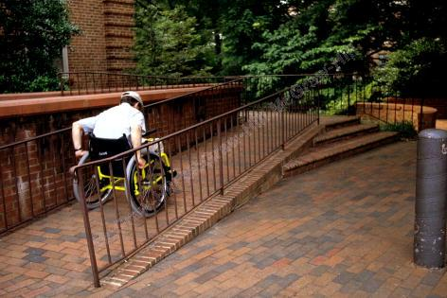
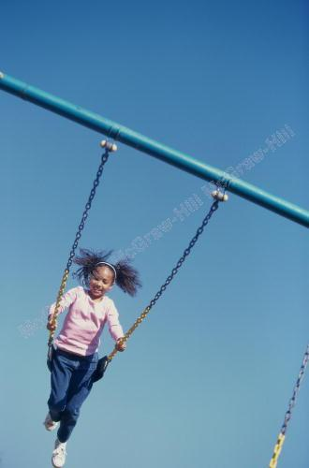
Kinetics of particle
We must analyze all of the forces acting on the wheelchair in order to design a good ramp
High swing velocities can result in large forces on a swing chain or rope, causing it to break.

Slide 3
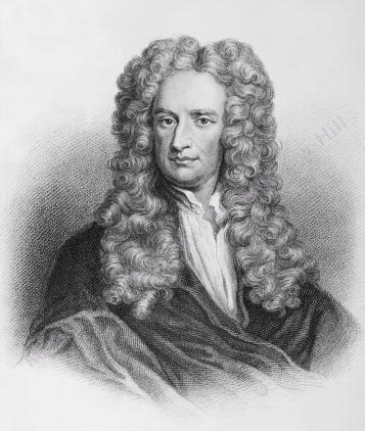
Newton’s laws of motion: Force, mass and acceleration
Newton’s Second Law of Motion
If the resultant force acting on a particle is not zero, the particle will have an acceleration proportional to the magnitude of resultant and in the direction of the resultant.
Must be expressed with respect to a Newtonian (or inertial) frame of reference, i.e., one that is not accelerating or rotating.
This form of the equation is for a constant mass system

Slide 4
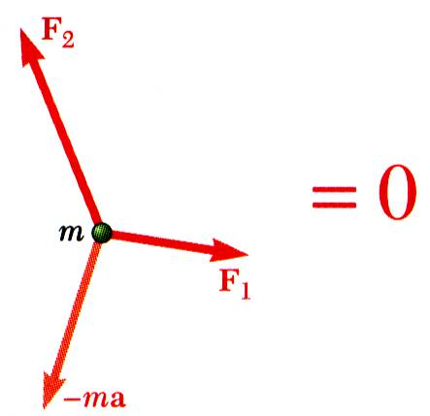
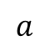
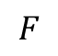
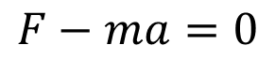
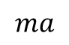
D’Alembert’s principal and dynamic equilibrium
Inertial forces may be conceptually useful but are not like the contact and gravitational forces found in statics.
$$ma$$
$$a$$
$$F$$
$$F−ma=0$$
D’Alembert’s Principle
Newton’s 2nd Law Vs. D’Alembert’s Principle
Newton’s 2nd Law is applicable when the frame of reference is inertial frame.
Inertial frame is the frame of reference which is either at rest or moving with constant velocity.
On the other hand, D’Alembert’s Principle is applicable when the frame of reference is non-inertial, i. e. accelerating.

Slide 5
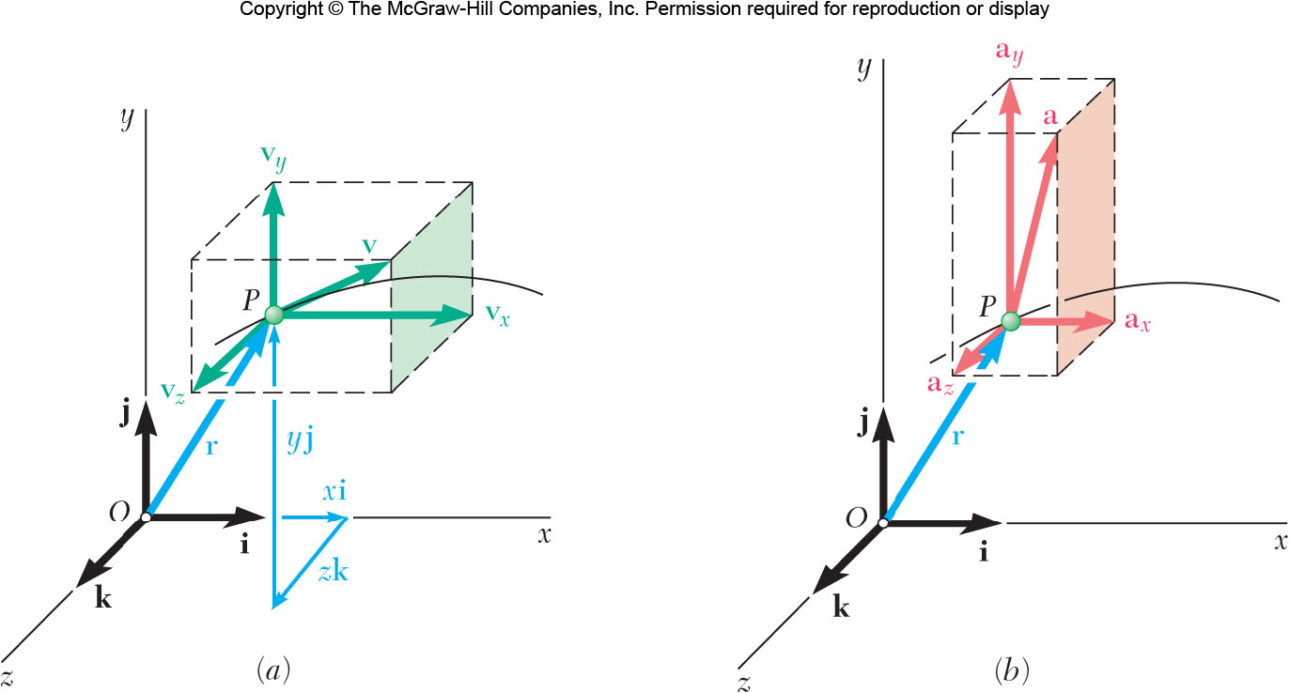
Equation of equilibrium
Newton’s second law
In terms of Cartesian coordinates:
Scalar component are

Slide 6
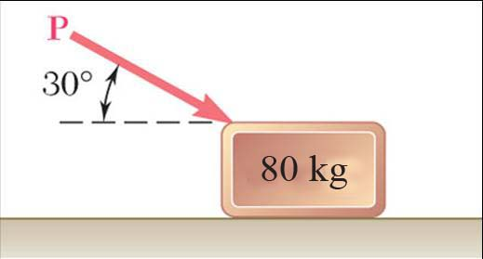
Problem-1
An 80-kg block rests on a horizontal plane. Find the magnitude of the force P required to give the block an acceleration of 2.5 m/s² to the right. The coefficient of kinetic friction between the block and plane is μ_{k} = 0.25.

Slide 7
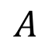
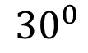
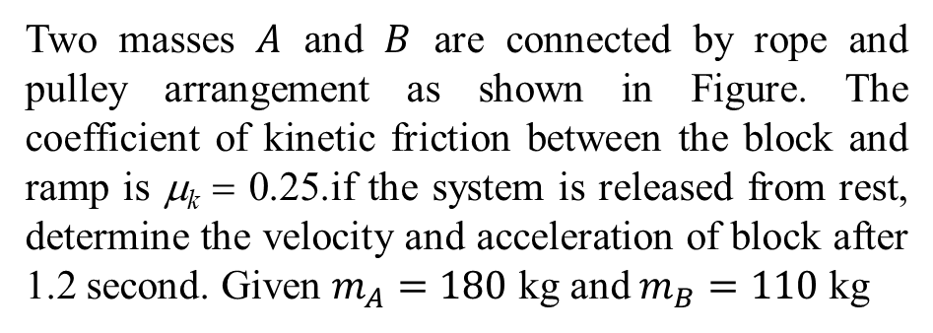
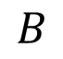
Problem-2
$$A$$
$$B$$
$${30}^{0}$$
Two masses $A$ and $B$ are connected by rope and pulley arrangement as shown in Figure. The coefficient of kinetic friction between the block and ramp is μ_{k} = 0.25.if the system is released from rest, determine the velocity and acceleration of block after 1.2 second. Given $m_{A}=180$ kg and $m_{B}=110$ kg

Slide 8
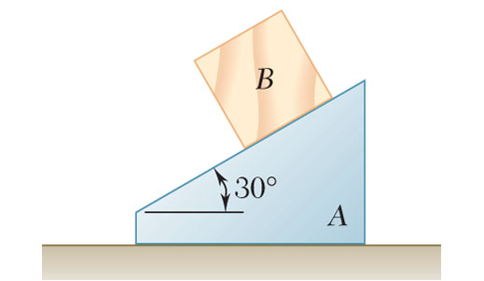
Problem-3
The 6-kg block B starts from rest and slides on the 15-kg wedge A, which is supported by a horizontal surface.
Neglecting friction, determine (a) the acceleration of the wedge, and (b) the acceleration of the block relative to the wedge.

Slide 9
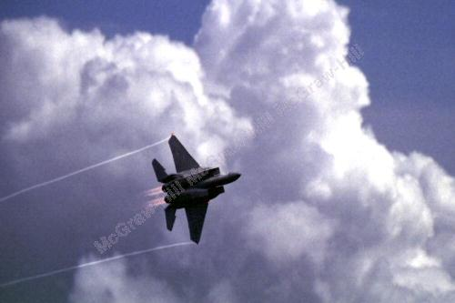
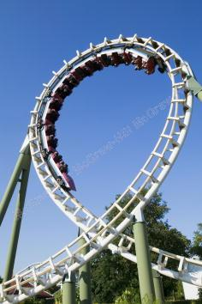
Normal and tangential component
Aircraft and roller coasters can both experience large normal forces during turns.

Slide 10
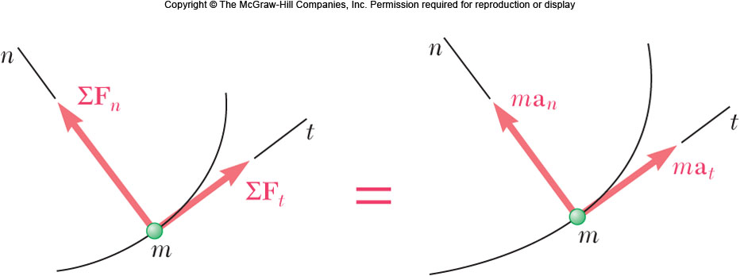
Normal and tangential component
Newton’s second law
For tangential and normal components,

Slide 11
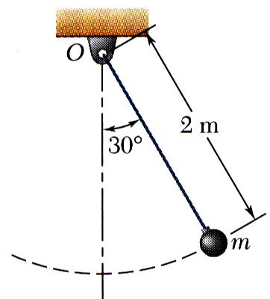
Problem-4
The bob of a 2-m pendulum describes an arc of a circle in a vertical plane. If the tension in the cord is 2.5 times the weight of the bob for the position shown, find the velocity and acceleration of the bob in that position.

Slide 12
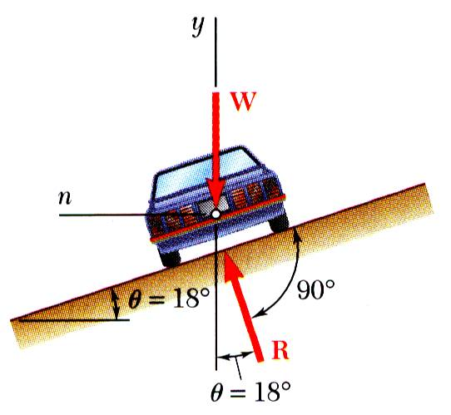
Problem-5
Determine the rated speed of a highway curve of radius ρ = 20 m banked through an angle θ = 18º. The rated speed of a banked highway curve is the speed at which a car should travel if no lateral friction force is to be exerted at its wheels.

Slide 13
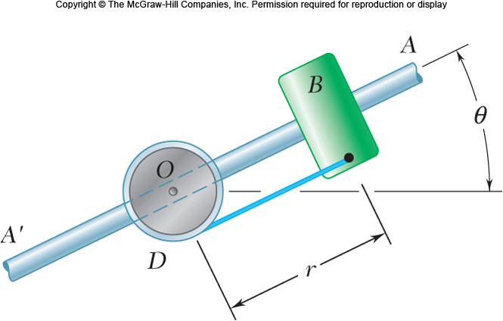
Problem-6
The 3-kg collar B rests on the frictionless arm AA′. The collar is held in place by the rope attached to drum D and rotates about O in a horizontal plane. The linear velocity of the collar B is increasing according to v= 0.2 t² where v is in m/s and t is in sec. Find the tension in the rope and the force of the bar on the collar after 5 seconds if r = 0.4 m.

Slide 14
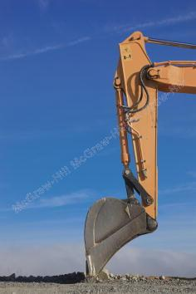
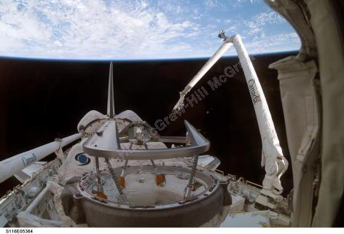
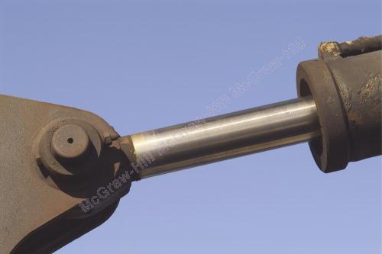
Radial and transverse component
Hydraulic actuators and extending robotic arms are often analyzed using radial and transverse coordinates.

Slide 15
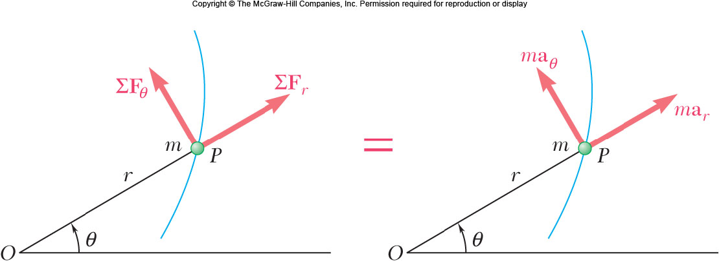
Equations of motion in radial and transverse component
Consider particle at r and θ, in polar coordinates,

Slide 16
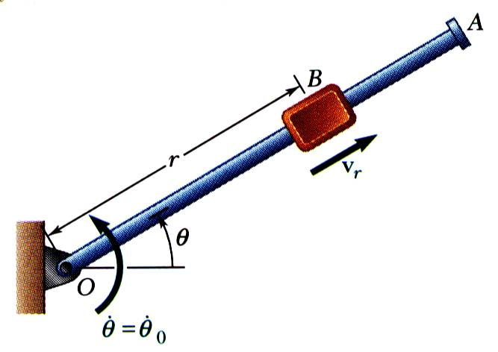
Equations of motion in radial and transverse component
A block B of mass m can slide freely on a frictionless arm OA which rotates in a horizontal plane at a constant rate
Knowing that B is released at a distance r₀ from O, express as a function of r .
the component v_{r} of the velocity of B along OA, and
the magnitude of the force exerted on B by the arm OA.

Slide 17
Equations of motion in radial and transverse component
The 3-kg collar B slides on the frictionless arm AA′. The arm is attached to drum D and rotates about O in a horizontal plane at the rate , where and t are expressed in rad/s and seconds, respectively. As the arm-drum assembly rotates, a mechanism within the drum releases the cord so that the collar moves outward from O with a constant speed of 0.5 m/s. Knowing that at t = 0, r = 0, determine the time at which the tension in the cord is equal to the magnitude of the horizontal force exerted on B by arm AA′.

Slide 18
Acknowledgement
NPTEL lectures on Engineering Mechanics
Beer & Johnston, Vector Mechanics for Engineers
Meriam & Kraige, Engineering Mechanics
Problems taken from internet sources
Timoshenko & Young, Engineering Mechanics

